Slide 1
AI-Assisted Code Autocompletion Tool
Ved Patel

Slide 2

Goals
-Create an IDE extension which suggests completions for partially completed lines
-Create Bison rules to leverage Automata Theory concepts to verify syntactic validity of AI recommendations
-Suggest syntactically correct completion proposal to the user

Slide 3
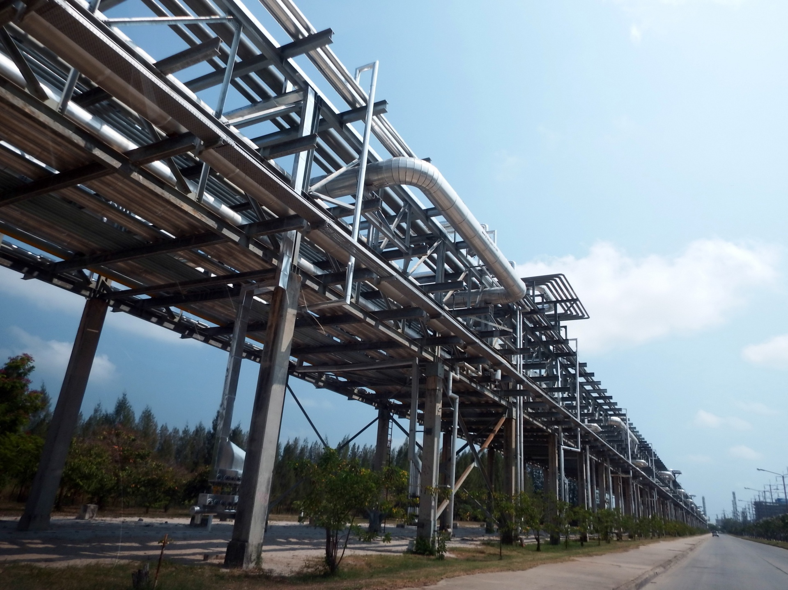
Pipe line
-Gradle UI API
-Code prediction AI
-Chat GPT2 small
-Fine tuned on a 700k C corpus using hugging face
-Verifier
-Lex tokenizer and Bison formal language programming

Slide 4
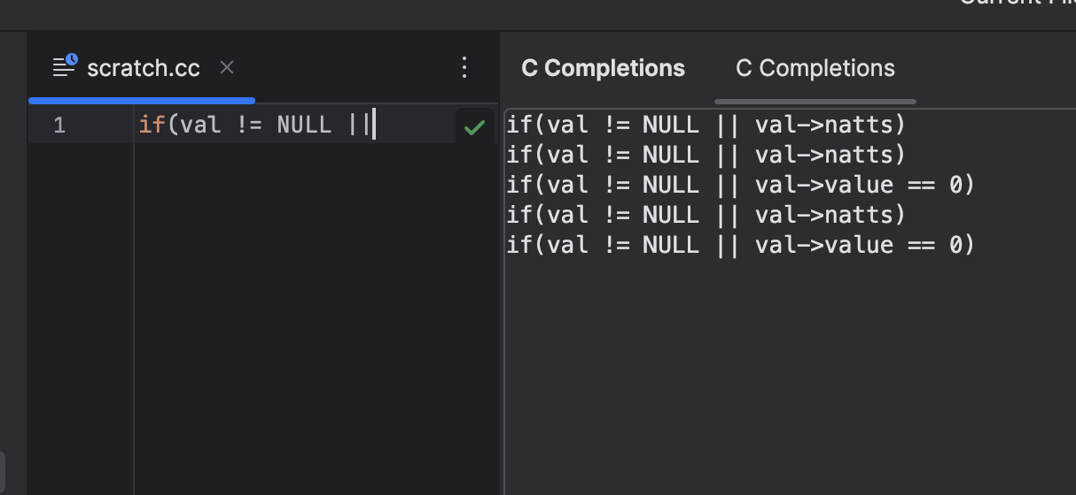
IDE Extension
-Retrieve context and partial line
-Send data to local LLM API for prediction
-Send prediction to verifier
-Display valid predictions to user

Slide 5
User Interface Implementation
Debounced live-updates
Attached a DocumentListener to the open editor
Used an Alarm with a 300 ms delay to avoid flooding the AI on every keystroke
Swing UI panel
A JTextArea inside a JScrollPane within a JPanel
Exposed as a non-modal, docked tool window via <toolWindow> in plugin.xml
JSON → Java
Read only the first [ … ] line of stdout from Python
Parsed with org.json.JSONArray
Rendered each array element as its own line in the text area
Icon & resources
16×16 SVG placed in src/main/resources/icons/ideToolWindow.svg
Referenced in plugin.xml as icon="/icons/ideToolWindow.svg"

Slide 6
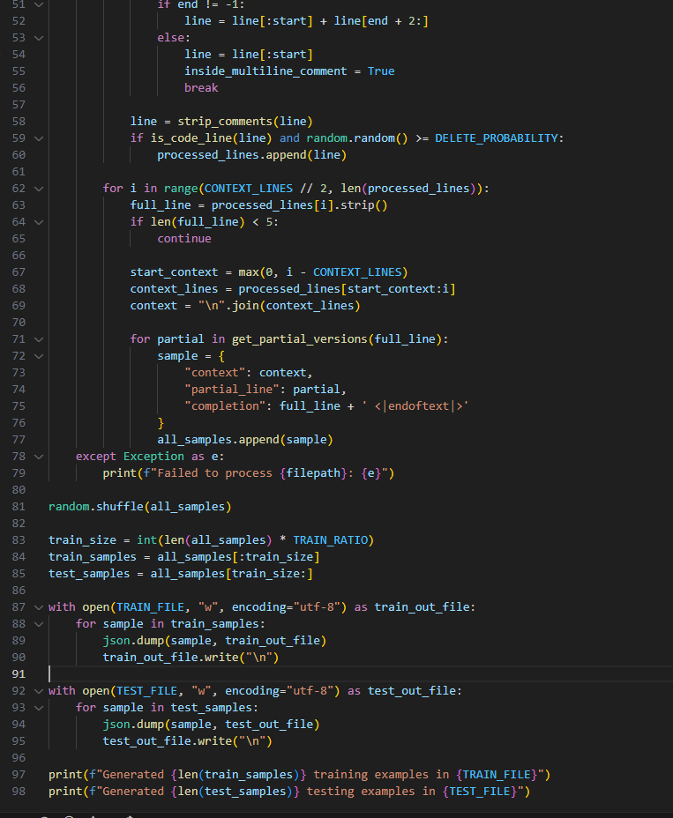
GPT2 Train and Test Data
-Cloned git source repo
-Used command prompt to purge all but .c and .h files
-Wrote a preprocessor to organize into JSONL train data

Slide 7
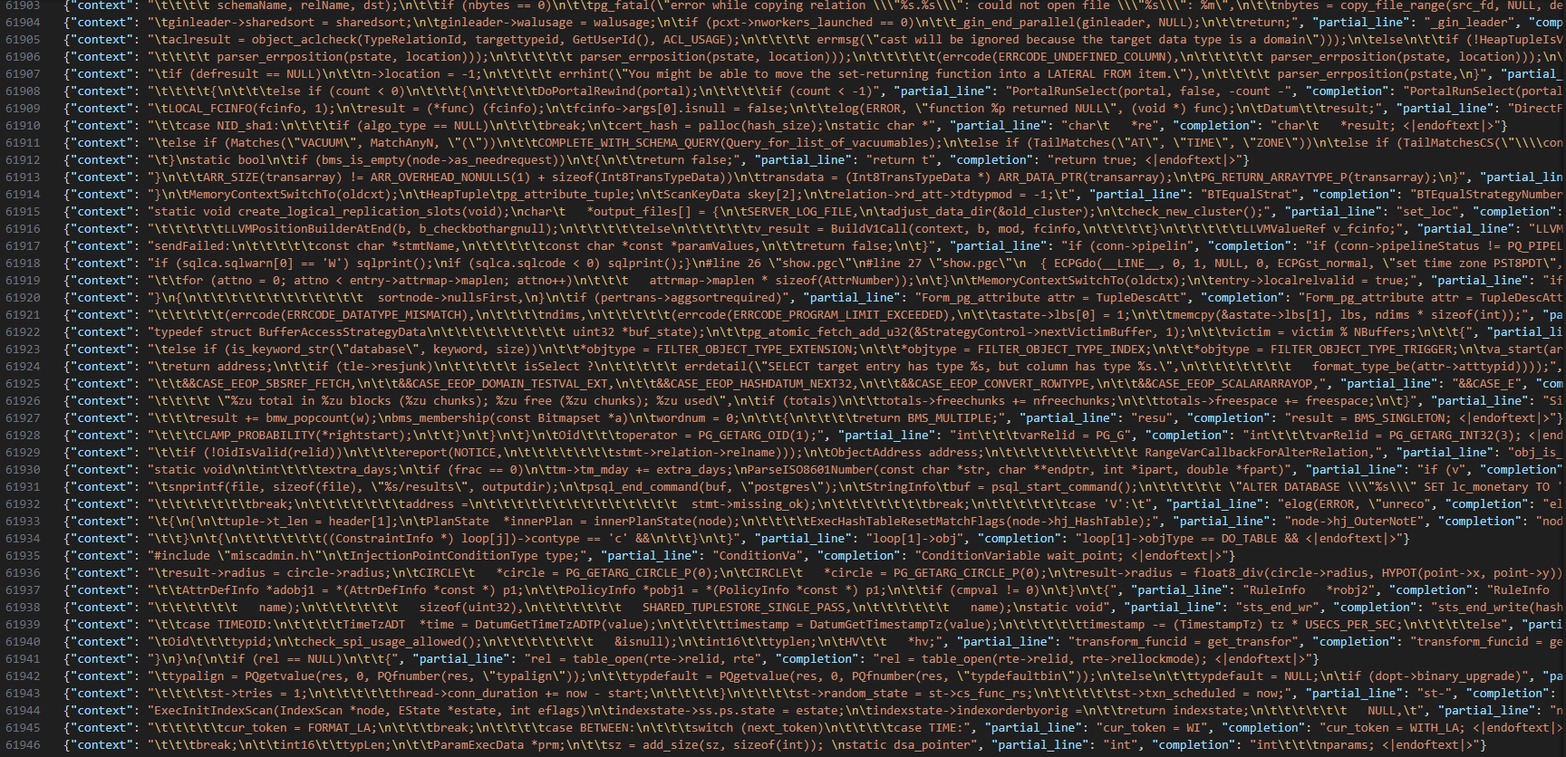
Test and Train Data

Slide 8
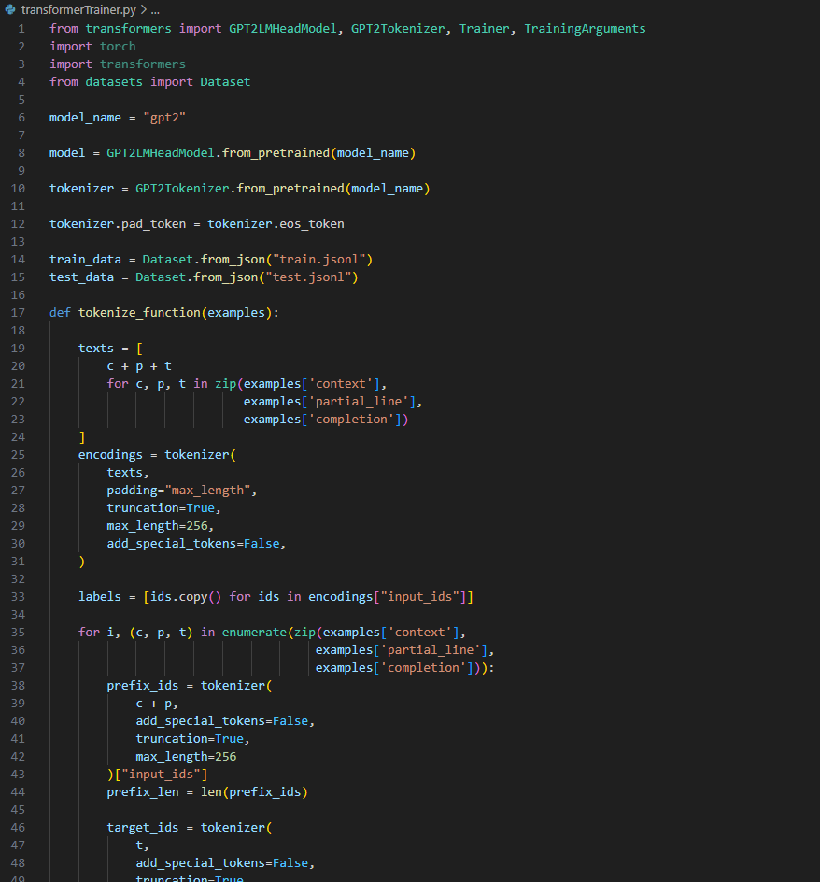
GPT2 Fine Tuning
-Used torch and transformers dependencies
-Tokenization fed the transformer context and partial lines
-It was rewarded for only completions
-This was accomplished using token masking
-Final fine tuning showed loss drop from 6 to 1.2.
-This represents mostly GPT2 learning the format and
Task, not true learning of coding

Slide 9
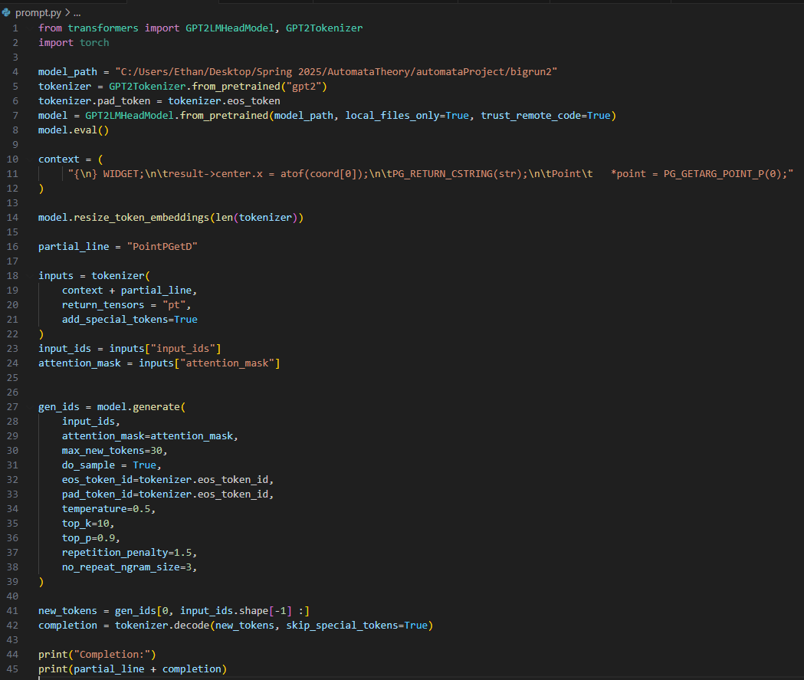
Prompt Script
-To actually use inference a python script was used
-Configuration is mostly in side this file
-Various arguments allow the the model to have vastly different outputs

Slide 10

Challenges
-Significant issues were encountered
-GPT2 is not coherent or intelligent
-Predictions should be viewed as statistical
not as actual thinking
-Issues with getting it to actually predict text
-Issues with teaching it when to stop
-These issues were overcame through extensive
trial and error
-About 10 small fine tunes and 2 overnight fine tunings

Slide 11
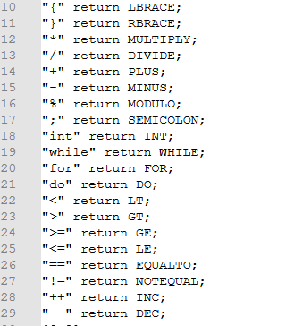
Flex
-A lexical scanner generator
-The program takes in rules from the user for pattern matching text in a file
- These patterns can be string literals or regular expressions
- The scanner generates tokens which can be used in the CFG inputted into Bison

Slide 12
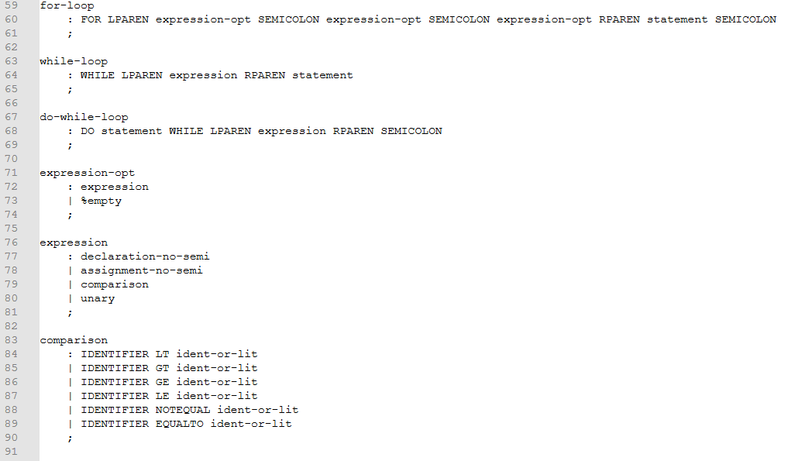
Bison
-A parser generator
-Takes a CFG from the user to generate a program that can understand and process a language
-Using this we can identify “irrecoverable single line errors” if the text cannot be parsed.
-Allows us to eliminate spurious suggestions to the user

Slide 13
The Verifier
Uses a subset of the C grammar to verify if an inputted line of C code is syntactically valid.
The program parses the line in a bottom-up fashion.
Reduces a line of code to the start symbol if it is syntactically valid
After this reduction, returns 0 for success, 1 otherwise

Slide 14
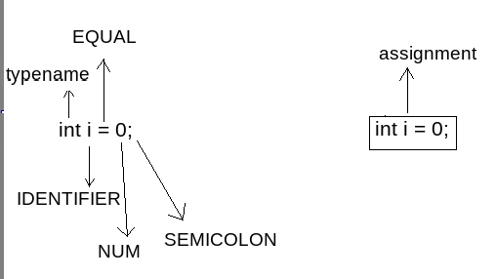
Example
This production rule is in the CFG given to Bison:
assignment -> typename IDENTIFIER EQUAL statement SEMICOLON
This line can be reduced to the nonterminal symbol "assignment"
"assignment can then be reduced to the start symbol "translation-unit"
returns 0 (syntax checks out!)

Slide 15

Future Work
-The project scales well form undergrad to megacorporation
-Each stage could be improved
-The UI could be cleaned up to be more user friendly
-A model better than GPT2 could be used, or fine tuned with more compute
-The lex/Bison pipeline could be expanded with more functionality for verification, such as integration to the give the LLM instant feedback

Slide 16
Demo Time!
Notes:
for (int i = 0;
if(val

Slide 17

Q/A

Slide 18
Resources:
-All images our own creation or creative commons
-Repo used : https://github.com/postgres/postgres

